Slide 1
Data Extraction and Visualization of Form-like Structured Documents
Vishal Salgond - 1814107
Darshan Satra - 1814109
Nikhil Sharma - 1814114
Param Shendekar - 1814115
Group 5 | Mentor: Mrs. Dipti Pawade

Slide 2
Agenda
01
02
03
04
05
06
07
08
Problem Statement
Motivation
Scope
Tech Stack
Overview of the Platform
Design
Workflow Diagram
Dataset Description

Slide 3
PROBLEM STATEMENT
Create a platform that takes templatic form-like documents as input and using the Text Extraction technique and Sentimental Analysis can give valuable business insights about the desired and valid fields from the form. Analyzed insights will be then expressed in the form of visualizations which will help users/customers understand and improvise upon their work.

Slide 4
Where we want to be
Where we are
Visual Analysis
Automated Workflow
Lack of Analysis
Manual Work & Labour Cost
Precise & Accurate output
Errors & Mistakes
Need / Reason / Motivation

Slide 5

Scope

Slide 6
Functional Requirements
Non Functional Requirements
User should be able to upload their own form.
Feature to choose which fields upon which analysis is required.
Extract all fields and its values from the uploaded bulk amount of forms.
Personalized dashboard to view visual insights of data.
Recognizable and limited font styles of print media will be supported.
Form types supported will be limited.
Sentiment Analysis will be performed on fields specified by the user, and are compatible.
Visual Analysis will be different for different types of fields.
System administrator will have the highest view as well as edit access.
Field should be identified
The system should have the similar accuracy for the blank form and the filled form.
Availability will be high.
User authentication and security will be taken care of.
UI / UX should be aesthetic.

Slide 7

Technology Stack

Slide 8




Core Technologies
Django
React JS
Develop Backend that will store the data and run the model
To build user interface for uploading and visualizing the forms
MongoDB
Standard ML Libraries of Python
MongoDB
database for persistent data storage
Tesseract and Tensorflow

Slide 9





Project Tools
Jira
Overleaf
Slack
Jira is a proprietary issue tracking product for bug tracking and agile project management
Collaborative cloud-based LaTeX editor used for writing, editing and publishing scientific documents
Proprietary business communication platform
Whimsical
Draw.io
Wireframe Making Tool
Free online diagram software

Slide 10

Dataset Description
Most of the datasets contain Images (png, jpg) of various documents which include forms, surveys, prescriptions, etc. We will leverage these to train and build our models for Boundary Detection & Text Extraction
https://guillaumejaume.github.io/FUNSD/
https://paperswithcode.com/dataset/funsd
https://www.kaggle.com/shaz13/real-world-documents-collections
https://www.kaggle.com/patrickaudriaz/tobacco3482jpg
https://www.kaggle.com/whatsappbackup/forms-images

Slide 11
PLATFORM
WORKFLOW

Slide 12
01
02
03
04
05
06
07
Phase 3
Phase 5
Phase 7
For each form, extract value from each field with the help of metadata saved
Store the analysis in DB and show it in the dashboard for better visualization
Collect the metadata of each field for future use
Phase 1
Admin will add the empty form
Phase 2
Phase 4
Phase 6
Platform will detect each field and ask the value type of each field
Analyze the extracted value according to the value type
Admin will add the required amount of forms to be analysed

Slide 13

Design

Slide 14

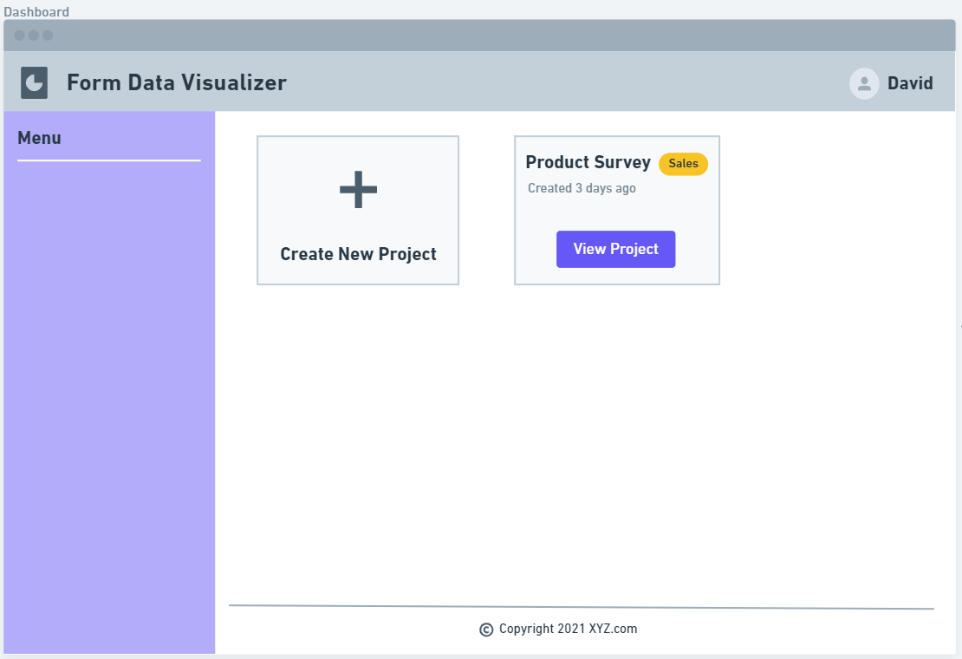
Dashboard

Slide 15
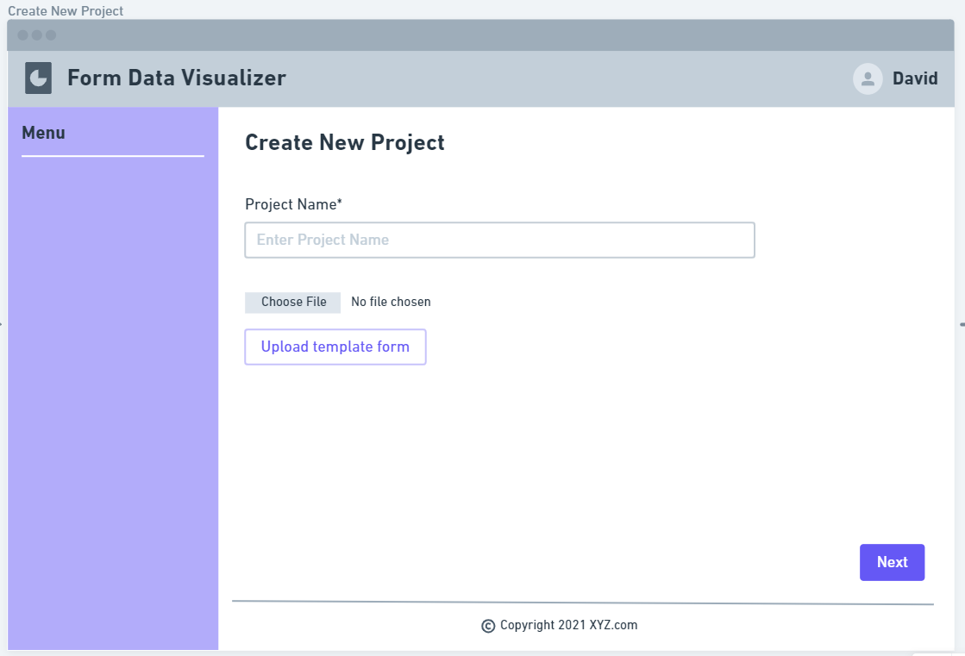
Create New Project

Slide 16
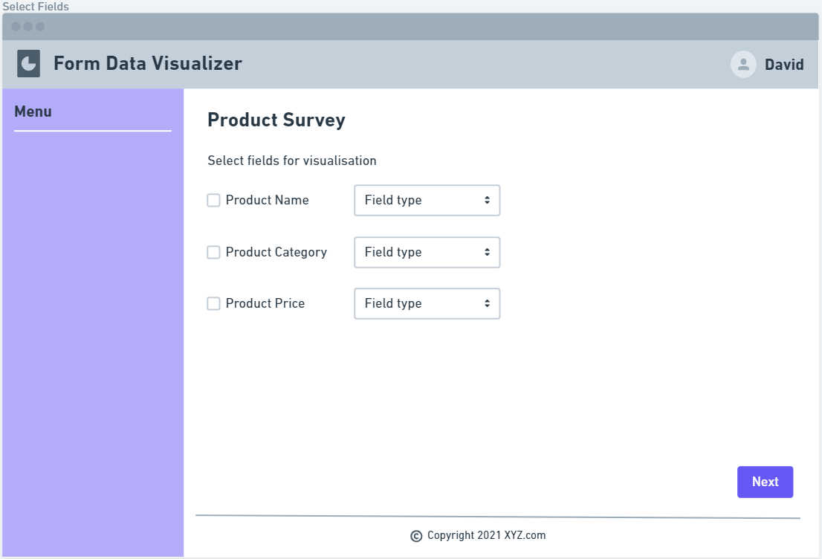
Select Fields

Slide 17
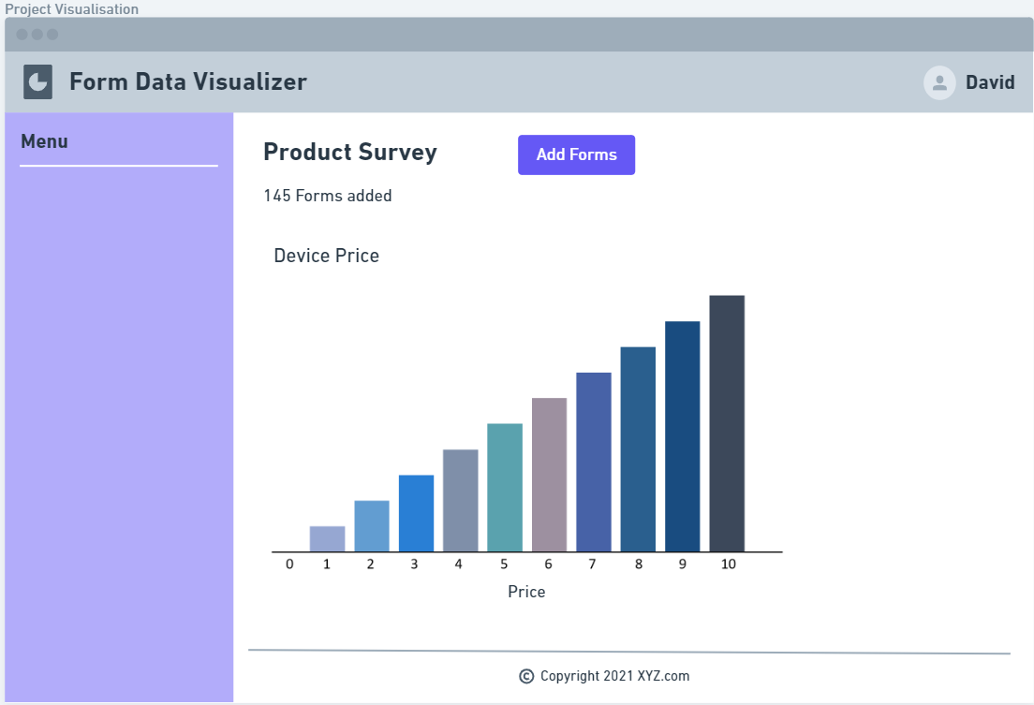
Visualization

Slide 18
References:
OCR with Tesseract, Amazon Textract, and Google Document AI: A Benchmarking Experiment
Segmentation of Scanned Documents Using Deep-Learning Approach
Form Field Frame Boundary Removal for Form Processing System in Gurmukhi Script
An Overview of the Tesseract OCR Engine
Name and Address Block Reader System for Tax Form Processing
Representation Learning for Information Extraction from Form-like Documents
Text Retrieval from Scanned Forms Using Optical Character Recognition
Kaggle

Slide 19
Thank You!

